Slide 1
REMOTE EXPLORATION METHOD (REM)
Structural lineament analysis and analogue modeling - identifying areas with promise of containing a mineral deposit
; vgalkin60@gmail.com
Cell:1-647 -501-0590
Vadim Galkin , PhD, Dr Sc,
P .Geo

Slide 2
The technique includes 4 independent methods (modules) Each individual method can be used for targeting, yet a combination of more than one is more reliable. Best result – fewer targets with highest probability – is secured by implementation and synthesis of all 4 methods together
Ricardo Valls, P.Geo
(Range Correlation Coefficient
Addition)

Slide 3
What is Lineament?
Natural lineament can be generally defined as linear feature on the earth surface visible on the map.
Lineaments are the result of heterogeneity (anomaly) of physical/chemical/biological properties underneath (faults and fractures in the first place)

Slide 4
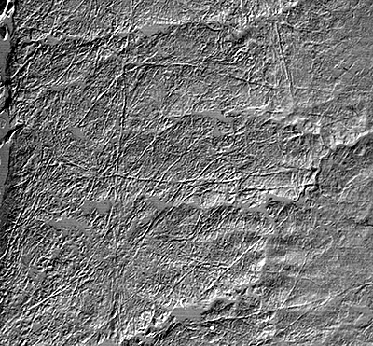
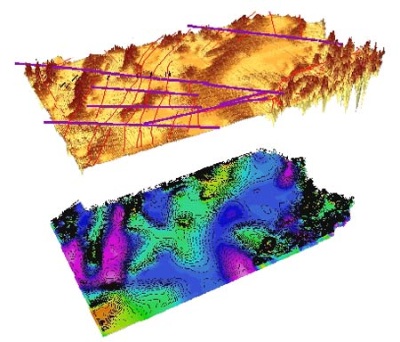
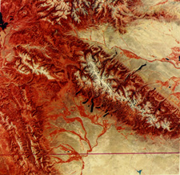
Lineaments can be seen and analyzed in Infrared, Radarsat, Landsat, air photo, geophysical fields, DEM, topo-maps etc
Notes:
Accordingly, one may speak of topographic, photo-, satellite, geological, geophysical lineaments etc. These linear features are, essentially, northing else but the surface reflection (projection) of either a geological body (such as a dyke or a layer, bed) or of a plane of anomalous physical properly (-ies) such as fault rupture, zone of mechanical weakness (or hardness), of high (low) permeability etc. Hence, by studying lineaments we indirectly study the surface pattern of the uppermost crust physical properly, and mainly - the distribution of fractures and faults projections
Lineament analysis as a method of obtaining new geological information has been in existence for at least 50 years. "Pros" and "contras" of the method have been discussed in numerous papers. The method is still considered to be a "mainstream" in hydro geology, where the direct links between water accumulation and fractures density pattern has been proved. Direct link with mineralization is not that straightforward, since the mineralization is usually geologically old, and the lineaments observed are believed to be of somewhat recent age.
On the other hand, more and more data are being published that prove the fact that the visible modern lineaments inherit to rather large extent the pattern of pre-existing fractures.
Anyhow, it seems to have become a fully accepted view that if taken in combination with other geological methods and applied with precaution, the technique might provide a researcher with new kind of valuable information which would have remained hidden otherwise.

Slide 5
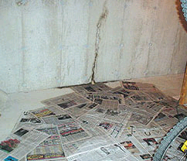
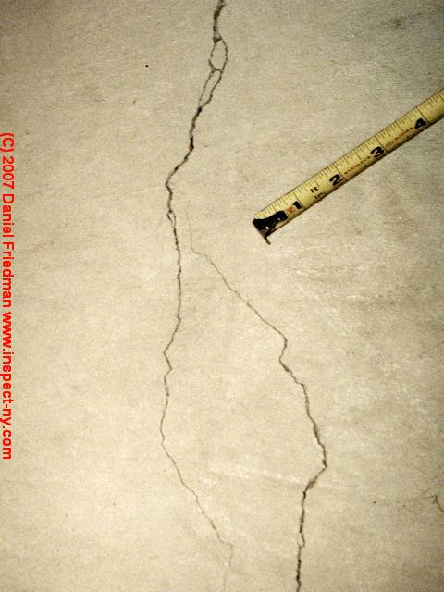
Gradual progressing and surfacing of the hidden linear flaws (anomalies) on the wall or floor
This is a good analogy of the “invisible” lineaments
development and surfacing
Notes:
Let me use another example to explain the nature of lineaments. For instance: if there formed some hidden linear (invisible) flaws on the wall/floor then, with time, they will be growing into more and more noticeable features due the wet-dry cycles. Eventually, such “wall or floor lineaments” will surface. Most important – following this lineaments towards the inside the wall or under the floor, we can get to the source of the leaking.

Slide 6
Notes:
There is almost complete analogy here with the uppermost section of the Earth crust. Small movements along the fault and the fluid flow with time, eventually will produce a zone of higher fracture density and alteration above. By studying the lineaments on the surface we can outline this zone as anomalous, and start looking for the underground deep structure. This structure can potentially lead us to the discovery of ore body.

Slide 7
How to draw lineaments
1
4
3
2
Notes:
Now, how to draw lineaments.

Slide 8
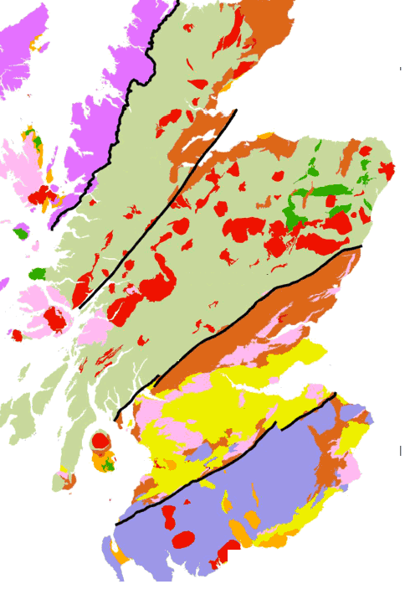
Geological Lineaments
Geological boundary
Between formations
Fault

Slide 9
Geophysical lineaments
Circular Lineaments
Notes:
Now, here is magnetic field map. Colors correspond to different values of magnetic susceptibility ) - Again, the change in color allows to draw linear features – and they mark abrupt change in physical property. In the center you can also see structures of circular shape. They are called circular lineaments. In most cases they correspond to projections of intrusive or extrusive bodies, and sometimes impact structures.

Slide 10
Straight lineaments ( projections of planes) can be divided into different scale groups, for instance:
Tertiary – small and shallow…
Secondary - medium length and depth
Main (long and deep)
Notes:
All lineaments can be divided (ranged) according their length - main, secondary, tertiary.
According to our classification:
Main lineaments can be clearly traced through at least 1/3 of a map or, if shorter, are of considerable width (may be represented as series of closely placed parallel lineaments).
Secondary lineaments can be seen as straight lines due to changes in surface pattern or gray color nuances extended through at least two UTM squares on the photo-topo-map.
Tertiary lineaments can be seen as straight lines due to changes in surface pattern or gray color nuances extended through at least one UTM square on the photo-topo-map.
Circular lineaments are curved (circular) segments or whole circles that can’t or hardly can be represented by combination of straight lines at the scale of study.
The lineaments may also be weighed
Weighing is somehow arbitrary and reflects the researcher’s conception of the lineaments nature and origin. From mechanical standpoint fractures and faults (which we observe as lineaments) form in some hierarchic order, usually from the smallest first to the largest. The fracture’s shape must be similar to a square or disc. So, the lineament, say, 200 m long may cut into the rock down to approximately 200m, and the main lineament 6 km long¸ accordingly, to 6 km down. Such a conception may be an oversimplification, yet the tendency of the longer and wider lineaments to penetrate deeper than shorter ones is a well established geological fact.
Apparently, an amount of fluid flowing through the main lineament is larger with comparison to the
tertiary one, and the mineralization is more likely to occur in the vicinity of the main lineament. Therefore, it makes sense to weigh (assign the importance value) the main lineament heavier than secondary, and much higher than tertiary. In our processing we used the following weighting coefficients: tertiary – 1, secondary – 3, main – 10

Slide 11
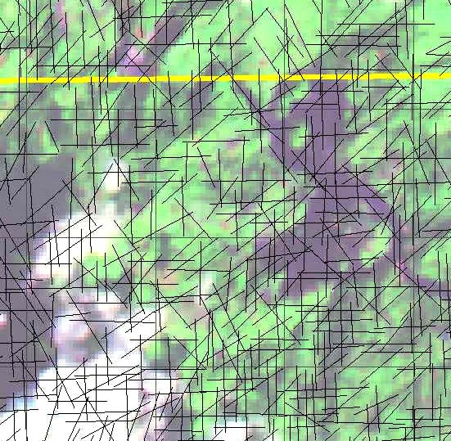
Tertiary Lineaments
(smallest chosen for the
area and image
Resolution)
Notes:
Tertiary lineaments can be seen as straight lines due to changes in surface pattern or color nuances in the image.

Slide 12
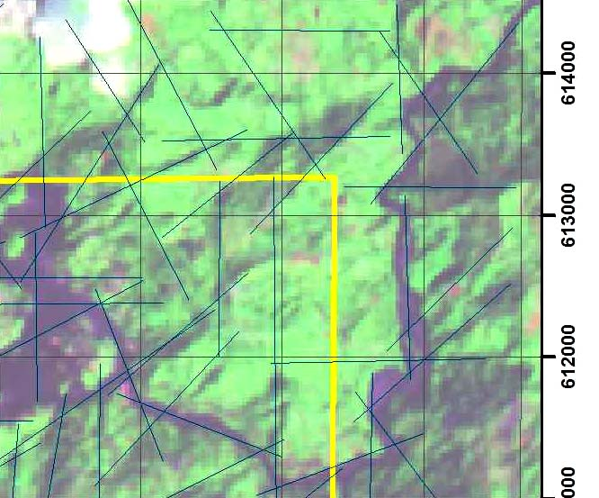
Secondary Lineaments
(most often 3-5 times
Longer than Tertiary
Lineaments)
Notes:
Secondary lineaments can be seen as straight lines due to changes in surface pattern or color nuances extended through several hundred meters.

Slide 13
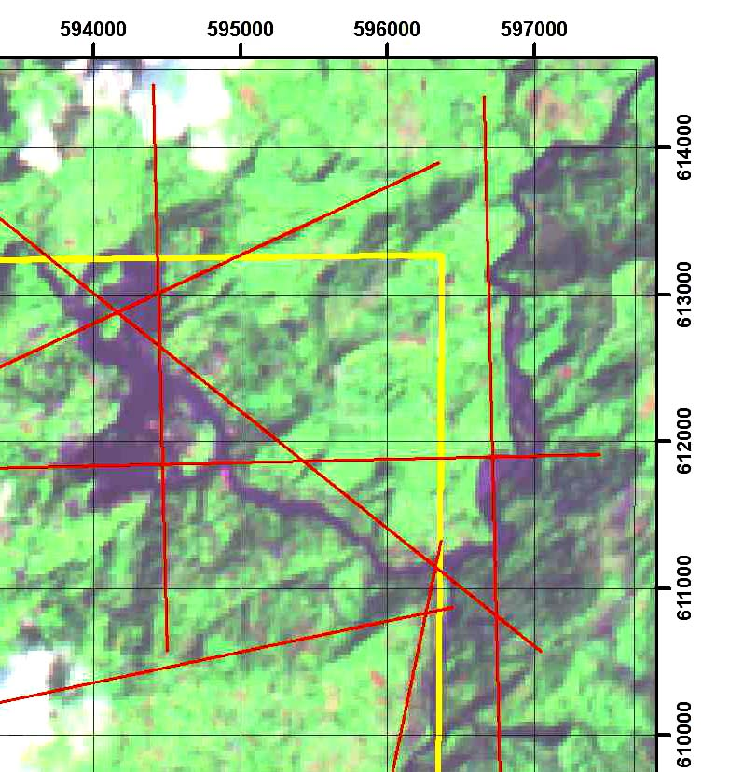
Main Lineaments – longest
for the area under the study.
Usually cross more then
1/3 -1/2 area dimensions.
Notes:
Main lineaments can be clearly traced through at least 1/2 of a map or longer, they are of considerable width (may be represented as series of closely placed parallel lineaments) and long ~ 4 -10 km for the area image

Slide 14
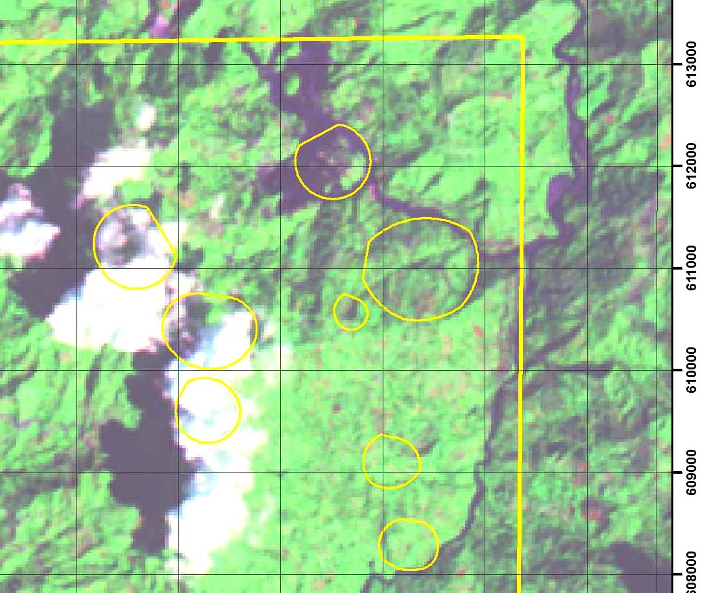
Circular Lineaments.
In some cases may be
divided into two-three
scale groups.
Notes:
The lineaments may also be weighed

Slide 15
Circular Lineaments.
In some cases may be
divided into two-three
scale groups.

Slide 16
Processing of the lineaments:
Calculate the number of different lineaments
in the windows of chosen size
Produce the maps of lineament densities (separately for
different scale groups, and combined)
Calculate the number of INTERSECTIONS of different lineaments
in the windows of chosen size
Produce the maps of lineament intersection
densities (separately for different scale groups, and combined)

Slide 17
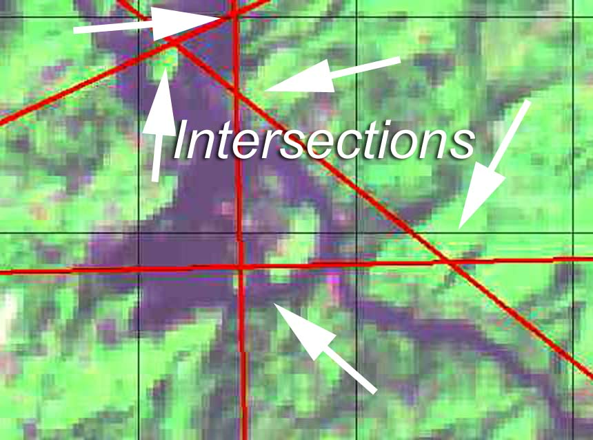

Slide 18
Notes:
Ok … the main output of the lineament analysis is a series of tables which gives us the number of different lineaments and their intersections ( like T_T, T_S, S_M and so on) – for the windows of the chosen size. The program that does the calculation was designed specifically for my technique.

Slide 19
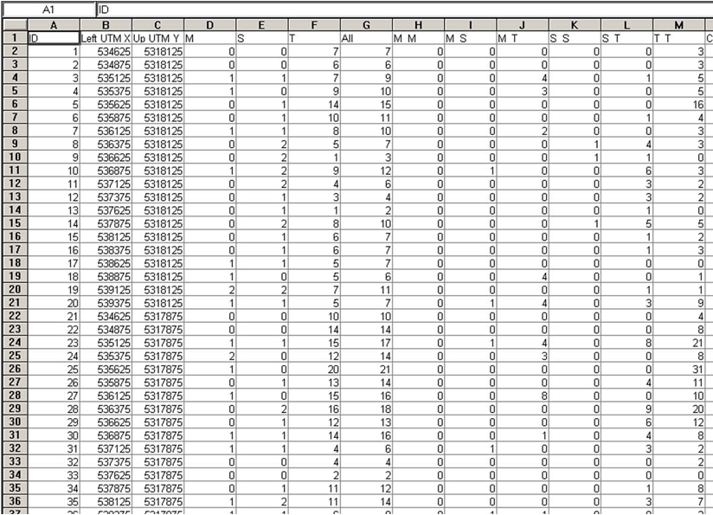
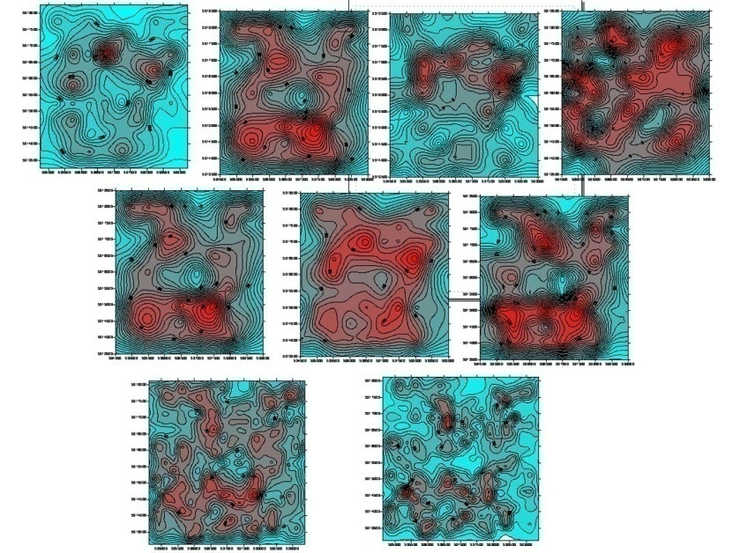
Lineaments are processed (rose diagrams, fractal dimensions, partial densities etc)
Notes:
These tables are then processed either in ArcMap or in Surfer, on in both, which results in the series of maps of lineament and their intersections densities. Basically, the maximums on the maps correspond in space to the most promising areas for further exploration efforts. They represent preliminary exploration targets.
In addition, the lineaments are processed in terms of their preferable orientations – rose diagrams of different type are built; from the standpoint of fractal dimensions and in some other ways. I will address these additional methods in the detail online course later.

Slide 20
Notes:
Let us stress the idea of the analysis one more time.
The resulted maps are contour maps of lineament (lineament intersections) densities. The maximums on such maps represent the areas with the highest lineament population (density), and therefore, with the highest permeability for any fluid flow passing through the system.
Contour maps of lineament densities for different lineaments and different averaging window sizes often repeatedly show same or spatially close areas with higher densities. These zones are taken as the most favorable for mineralization and may be recommended as the first target zones for future exploration activities.

Slide 21
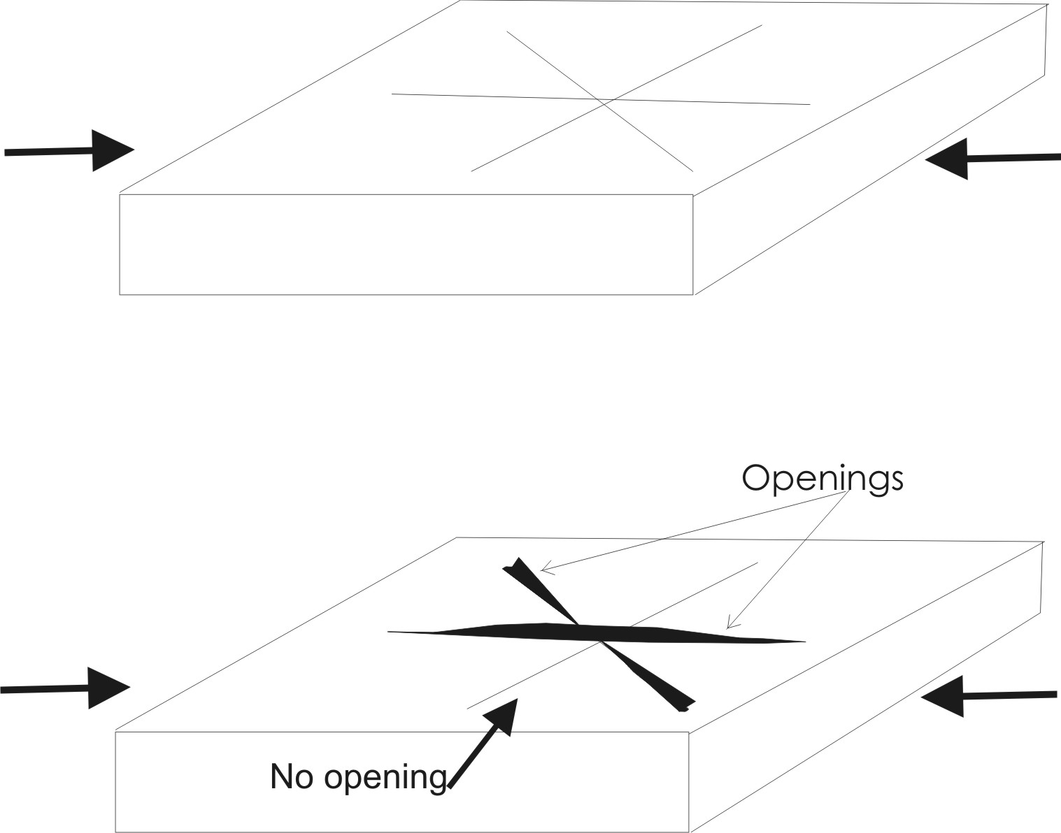
Main structures are known,
but how do they interplay?
Notes:
Now, we are done with lineaments. WE HAVE ALL OUR MAPS, WE KNOW THE Frame of the main lineament structures. But how they are interact?
Theoretical consideration as well as experimental results and geological practice indicate that only a few among many faults (fractures in experimental works) and their intersections play controlling role in deposit location whereas others serve either as pathways for fluid or don’t affect geological system at all.
This phenomenon becomes clear from the following simple experiment which everyone can reproduce at leisure time.
Let us take a rubber eraser and make several cuts on one of its facets. Then, press eraser from two sides horizontally. We will immediately see that openings form along some cuts (which are parallel or close to parallel to the direction of compression) whereas other cuts do not manifest themselves. Now LET US try to press this eraser in different direction, bend it, twist it, and play with it around. We will find a number of deformational patterns, yet initial system of cuts is the same. This experiment gives may be too general, yet a good analogy of faults /strain interaction in nature.
So, how can we understand better the interaction of the lineaments?

Slide 22
Notes:
Analogue modeling is a simplification of Nature; using this method, structures formed due to the deformation of rocks can be modeled and investigated.
Physical modeling deals with simulation of real geotectonic processes by using analogue materials instead of rocks, and substituting natural tectonic stresses, temperatures and pressures by specifically selected laboratory conditions.
Our lack of knowledge about "real" rocks is one of the major limitations to any kind of modelling of deformation. However, unlike their counterparts in Nature, the initial (undeformed) stages of analogue models can be documented, and can easily be compared with their later, deformed stages. This comparison is essential to gain an understanding of the evolution of the resulting structures. Analogue modeling is a relatively simple and inexpensive technique which can be very valuable as long as its limitations are well understood.

Slide 23
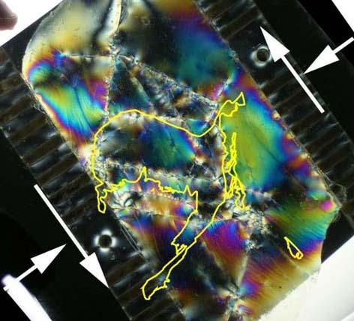
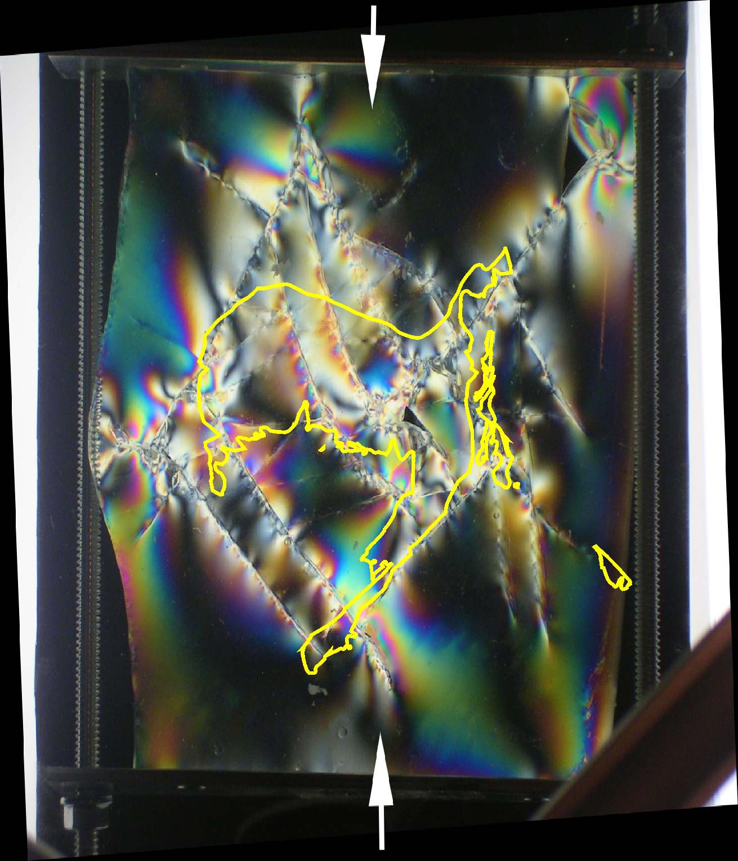
Elastic Field – optically active gelatin

Slide 24
Notes:
Basically, tectonic deformation, as any deformation, consists of three consecutive stages: elastic (reversible), plastic and rapture (permanent, irreversible).
To model elastic deformation we use elastic material - I use gelatin most often. To model the plastic and rupture deformation I use clay pastes.

Slide 25
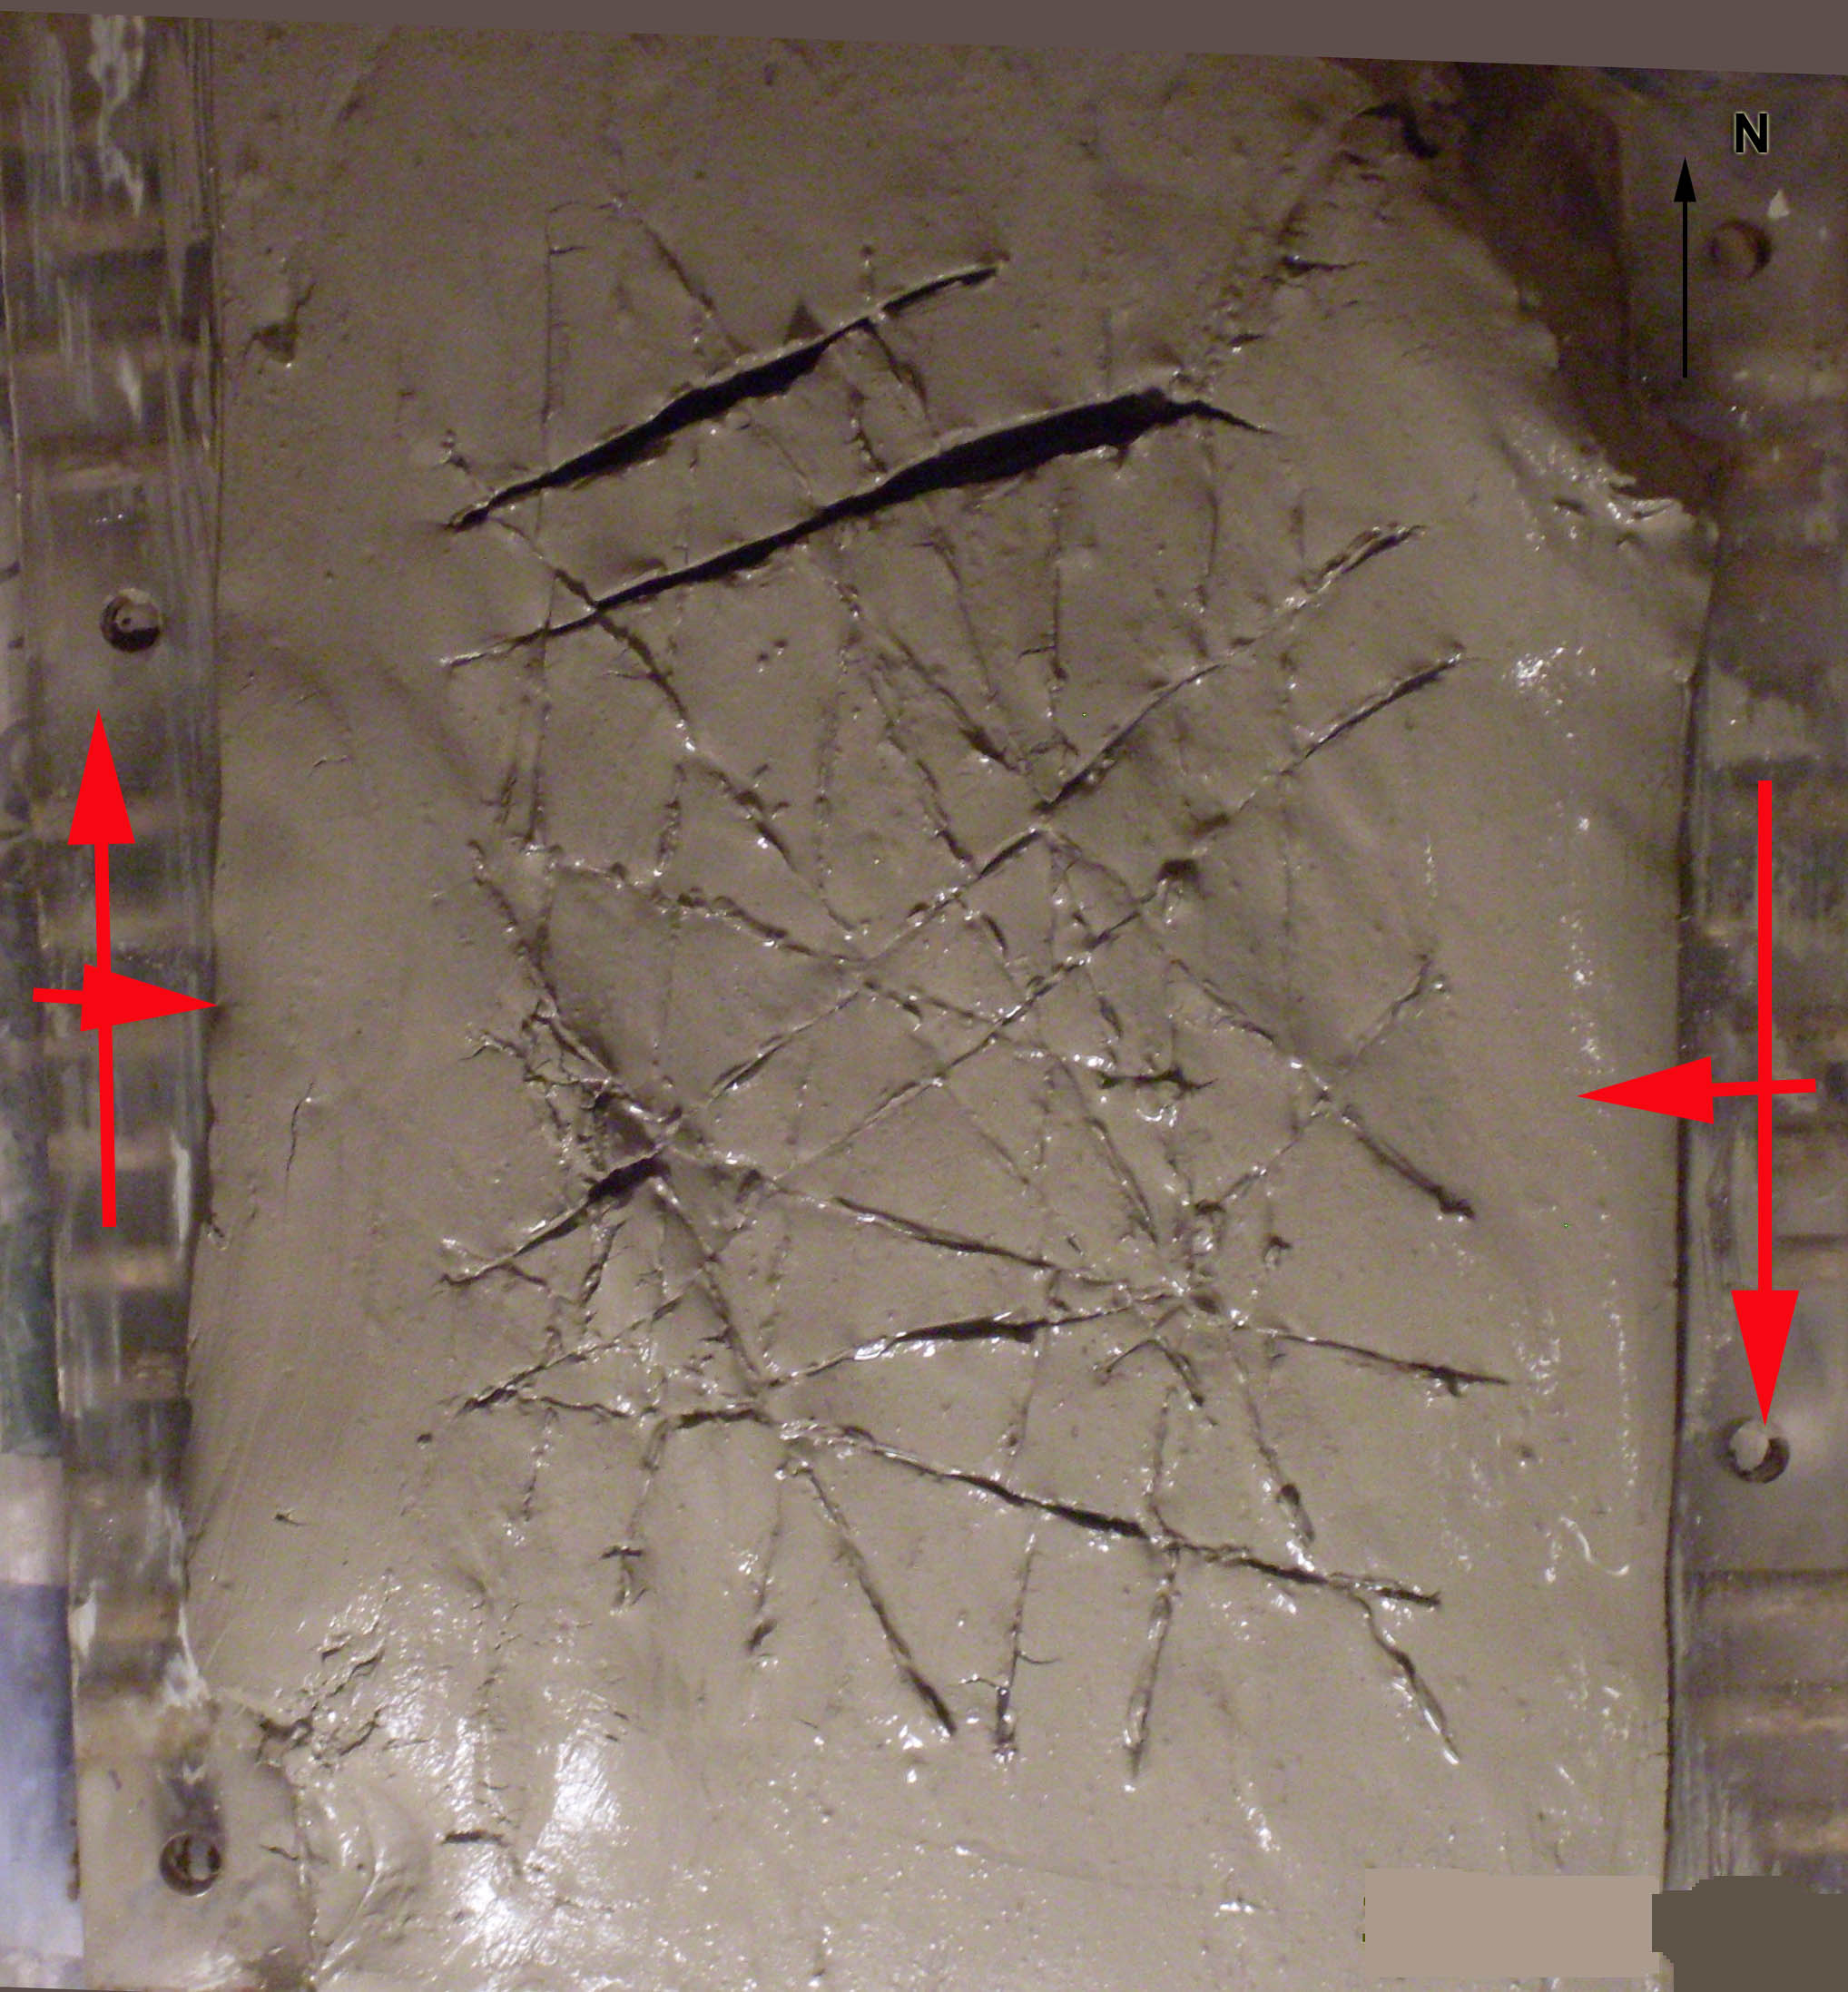
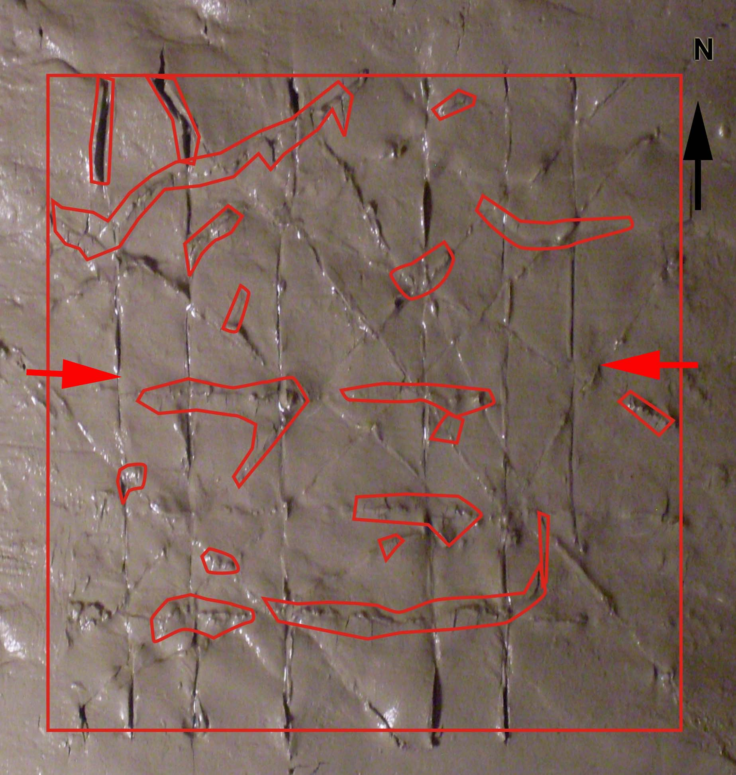
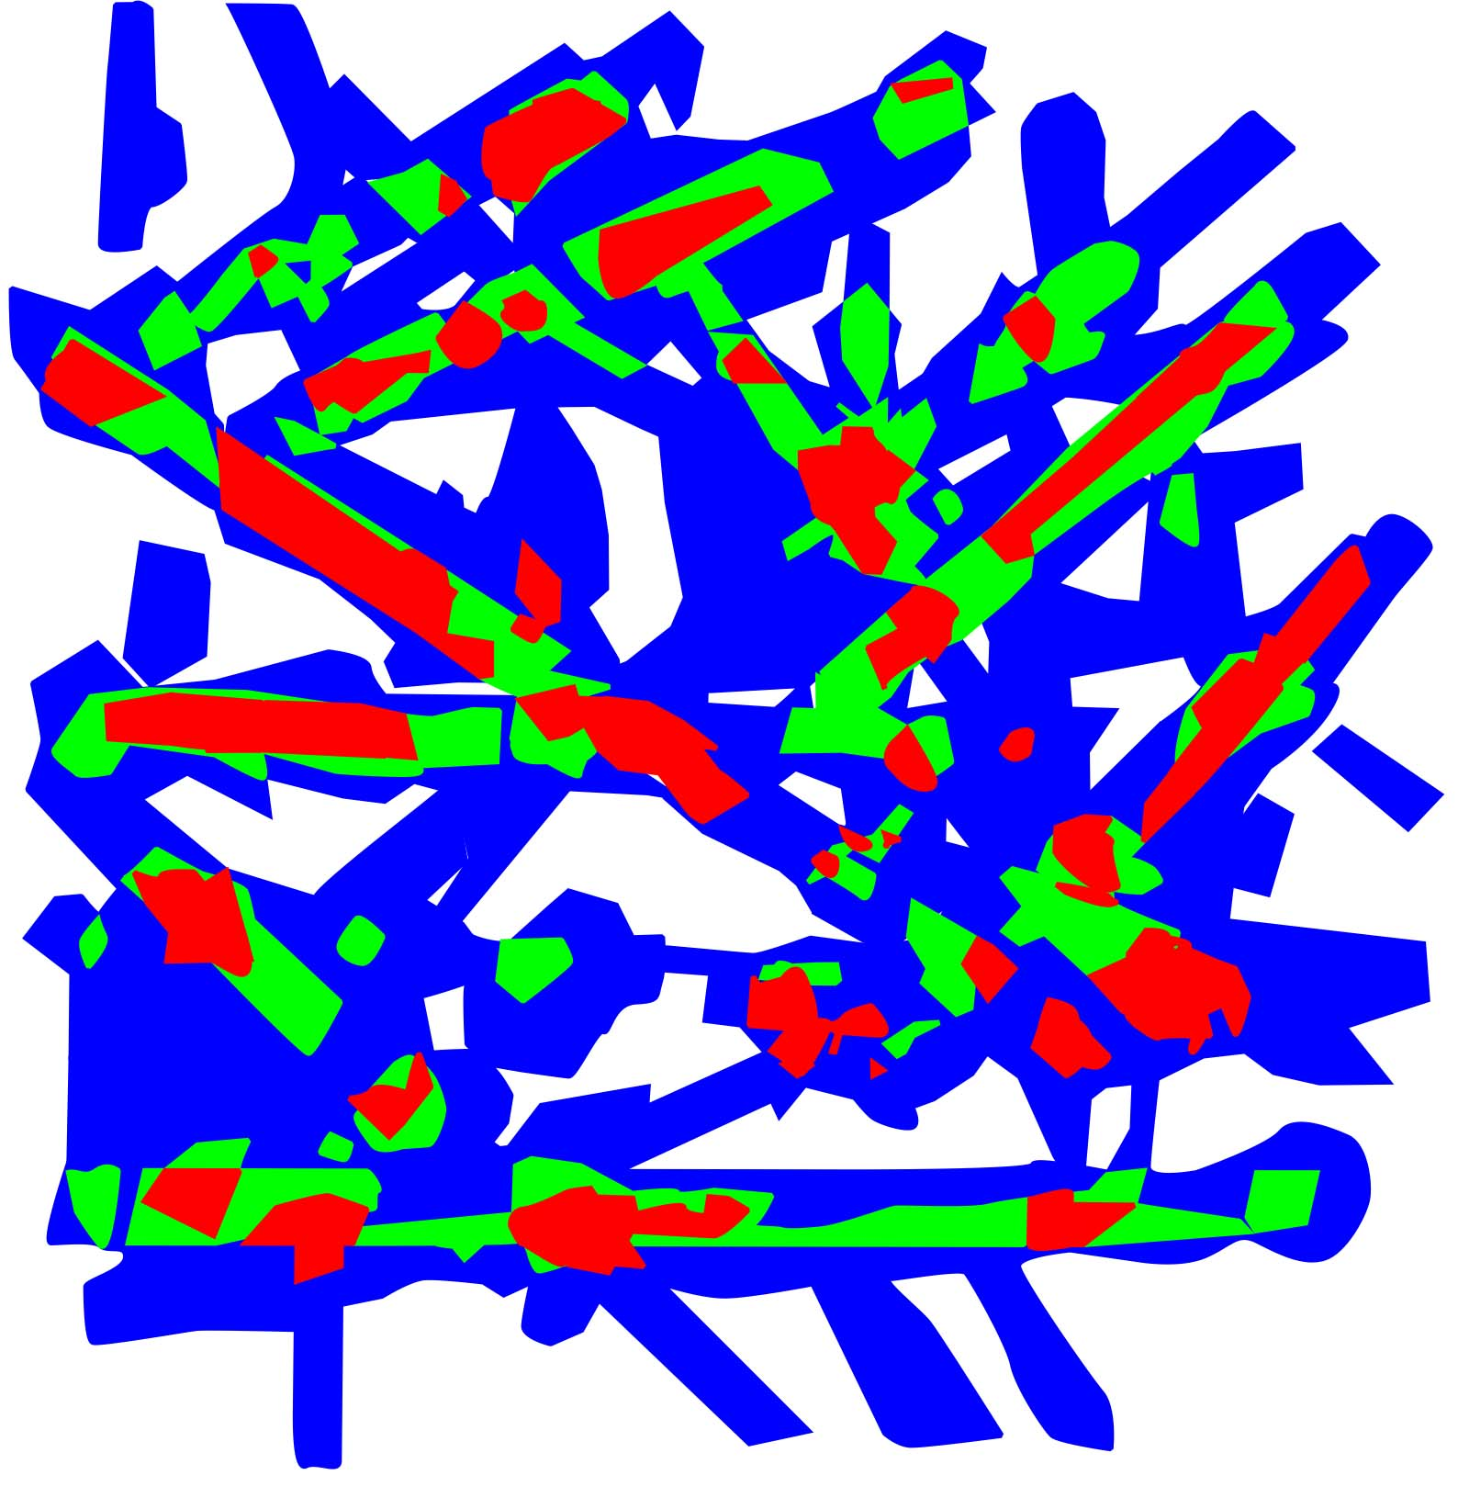
Principal Model
for Plastic Deformation
Experiments
One of the experiments
2
3
4
5
Notes:
Geological practice and theory tell us, that, in general, during the deformation mineralized fluids move from zone of high compressive stresses into zones of openings (raptures, fractures, faults) where they precipitate and form ore bodies.
So, we want to prepare a model with the main structures cut, and then, deform the model in all the possible directions and register and record the resulted structures.
Usually we record the experiments with digital camera. Then, processing the results, we outline the raptures and newly formed fracture zones in all the experiments. After that, we overlay all the experiments on each other, and outline the zones, where the raptures and openings happen in most of the experiments. Such zones from the modeling standpoint – may be taken as the potential traps for the mineralized fluid, and therefore,most favourable for the future exploration activities.

Slide 26
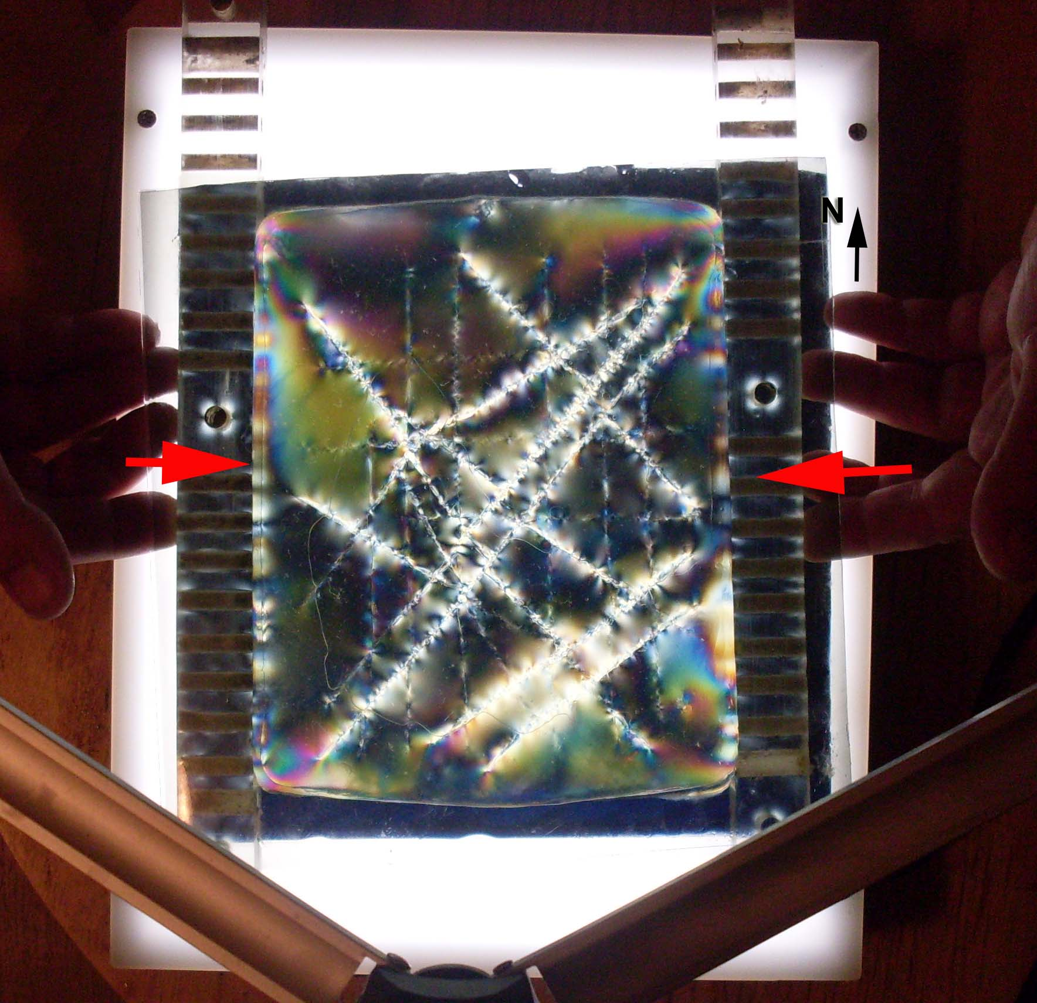
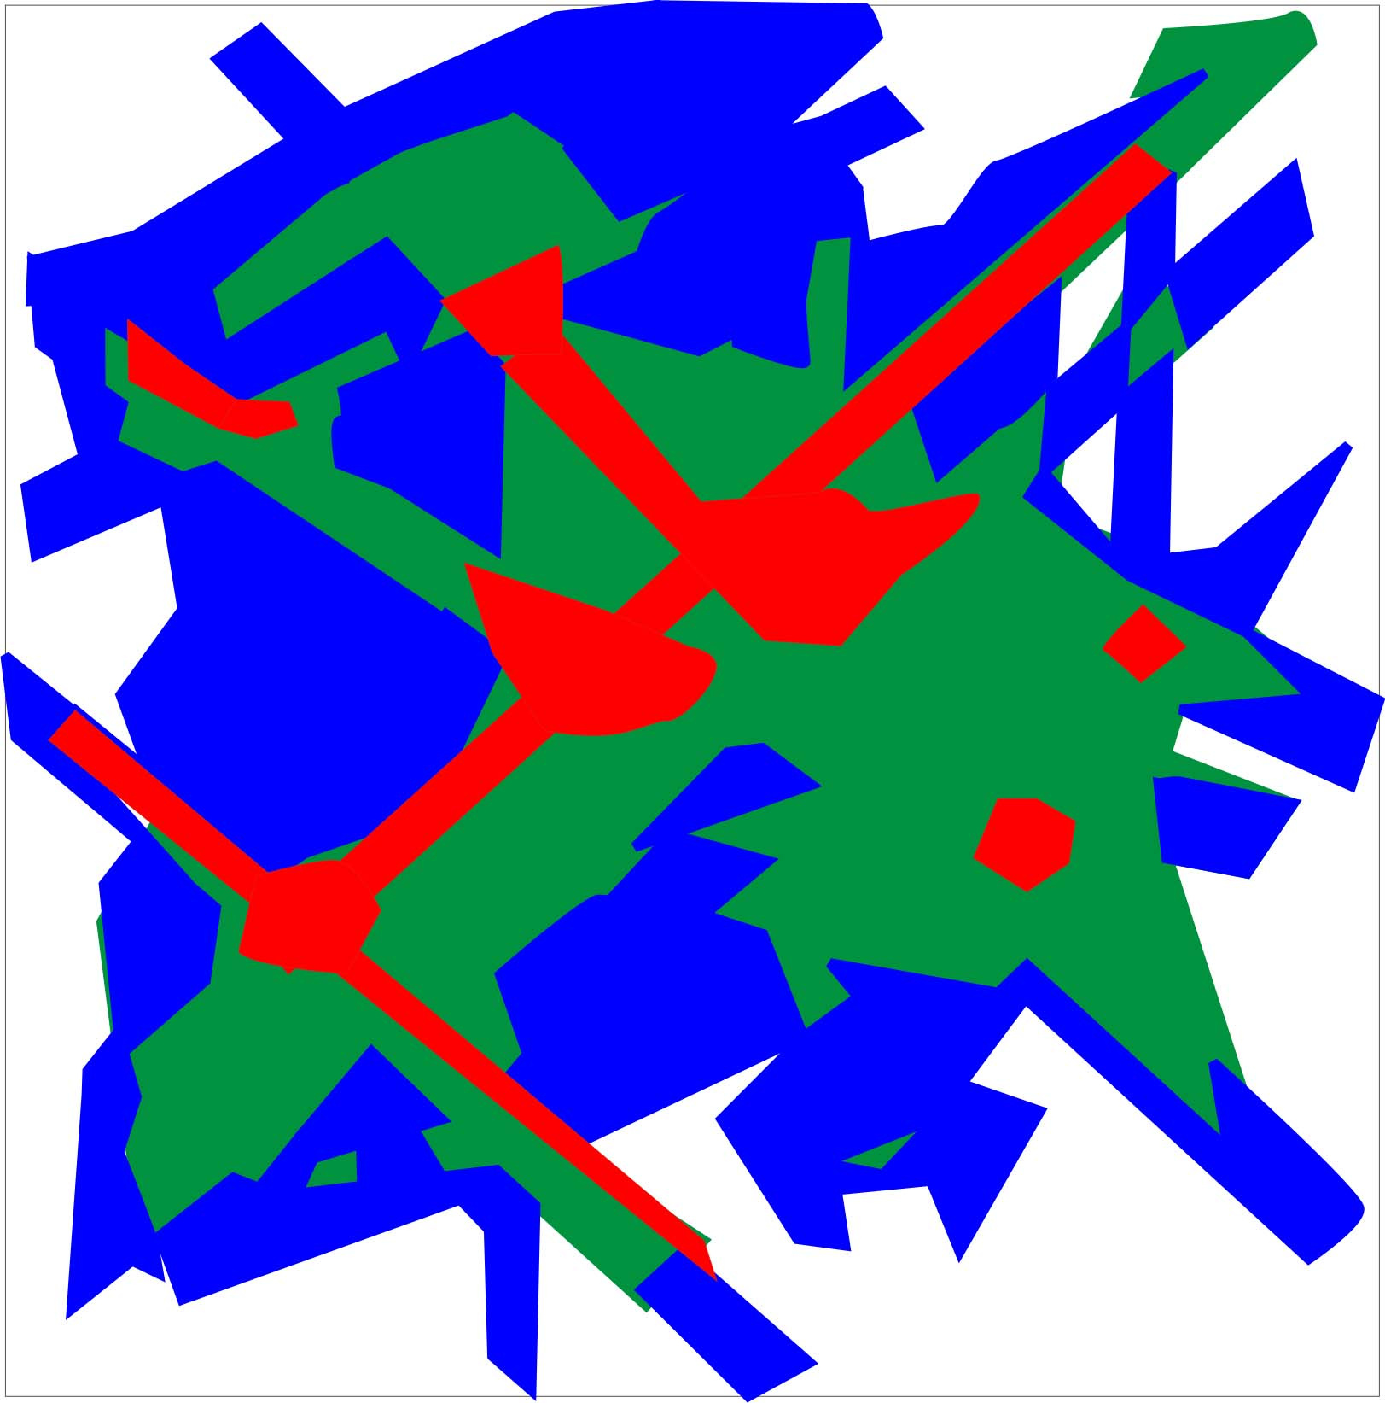
Notes:
The previous slide showed the plastic deformation and rupture experiments.
In this slide you can see the illustration of the same principle applied to the elastic deformation.

Slide 27
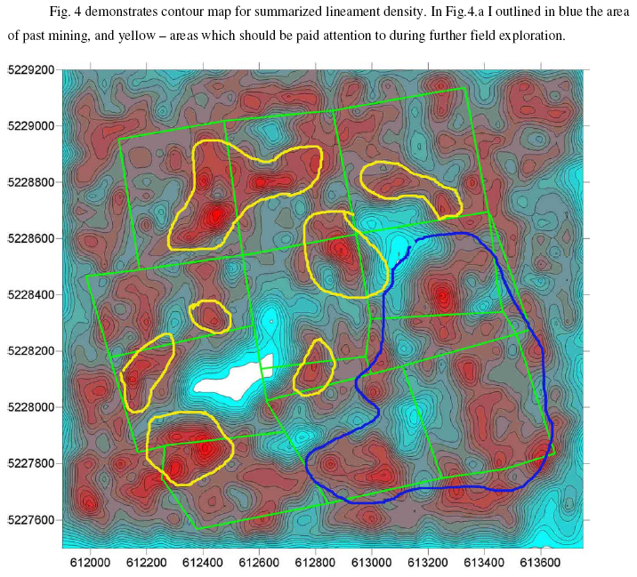
Overlaying and processing
independent results togethe,
With geology/geopgysics/geochemistry etc
WE BUILD FINAL EXPLORATION TARGET MAPS

Slide 30
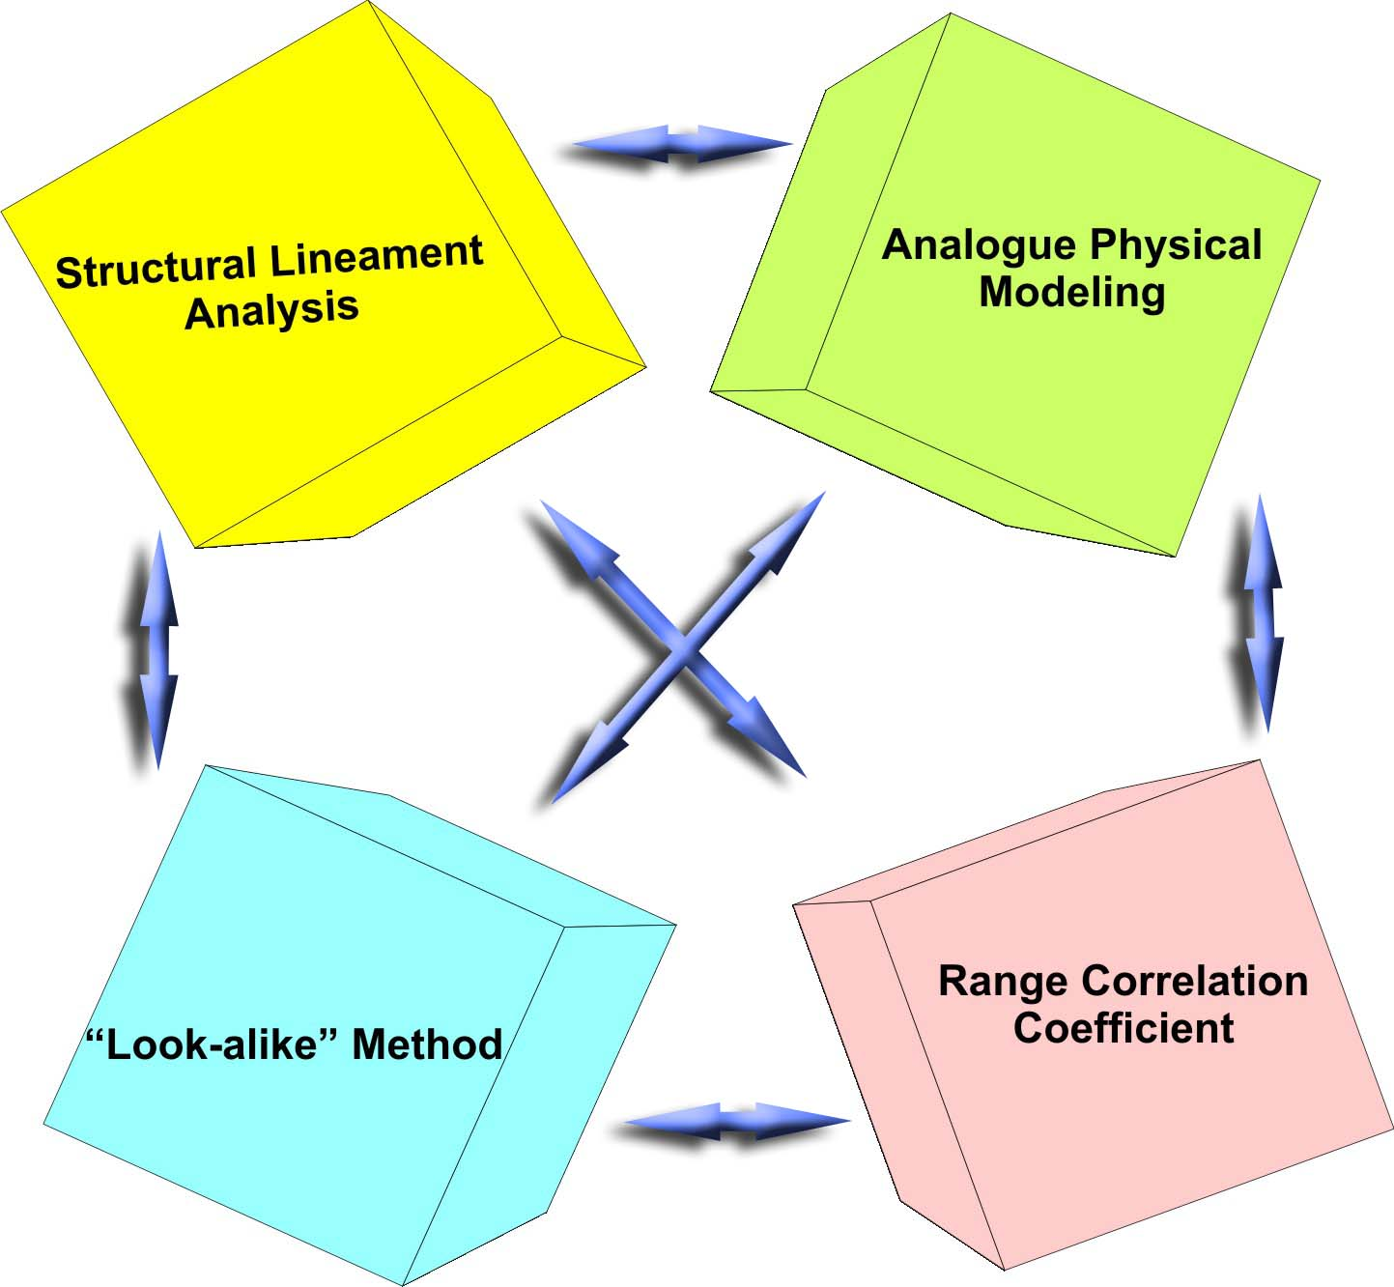
The “Look-alike” Method
Outlines zones with the same geophysical and other characteristics as the existing deposit
It is these zones that must be taken as targets for detailed prospecting, ground geophysics and/or drilling

Slide 31
Range Correlation Coefficient Method (R.C.C.)
(designed and implemented by Ricardo Valls)
After identifying the main tectonic structures and lineaments on the basis of sat-photos, aero-photos, or topographic maps, the number of these structures and their intersections are digitized using an appropriated grid and combined with the available geological, geochemical, or geophysical information. The data is then processed to determine the Range Correlation Coefficient (R.C.C.) that best characterizes the mineralized zone.

Slide 32
What will you have as the results?
LINEAMENT ANALYSIS
Maps of all lineaments on the properties – tertiary (smallest), secondary (medium)
main (regional scale) and circular (most often reflect intrusive bodies underneath)
Rose-diagrams maps for the properties and surroundings –
the spatial distribution of the preferred orientations of lineaments (fractures&faults)
Contour maps of various lineament densities and their intersections in various
combinations
Overlays of the maps above on the geology/geophysics/geochemistry (soil) or anything
else you have. Often it allows revealing new pattern in the relations between
mineralization and structure, and consequently it shows where to explore further for the
previously unknown mineralization zones.
Exploration Target Map based on the lineaments and additional info you already have –
for individual properties and surroundings.
In other words – you will have few new layers of data and interpretation based on ALL
data you have and on MY results from structural analysis –
NEW EXPLORATION TARGET MAPS.
And, of course, the report will wrap up all the results.

Slide 33
ANALOGUE MODELING
As a product to deliver you would have a report on the modeling with experiments pictures, interpretation and Exploration Target Map (based on the elastic and plastic deformation patterns).
In other words - again – you will have few new layers of data and interpretation based on ALL data you have and on MY results from structural analysis – one more NEW EXPLORATION TARGET MAPS for the properties.
Structural Lineament Analysis can be done separately, without subsequent Physical Modeling. Yet, the combination of two would be recommended, since it increases reliability of the interpretation.
R.C.C. statistical application is also very recommended. It could be done in pair with LA only, with additional layers of database (table) data, and with LA+PhM as well
Notes:
ANALOGUE MODELING
As a product to deliver you would have a report on the modeling with experiments pictures, interpretation and Exploration Target Map (based on the elastic and plastic deformation patterns).
In other words - again – you will have few new layers of data and interpretation based on ALL data you have and on MY results from structural analysis – one more NEW EXPLORATION TARGET MAPS for the properties.
Structural Lineament Analysis can be done separately, without subsequent Physical Modeling. Yet, the combination of two would be recommended, since it increases reliability of the interpretation.
R.C.C. statistical application is also very recommended. It could be done in pair with LA only, with additional layers of database (table) data, and with LA+PhM as well

Slide 34
REMOTE EXPLORATION
Structural lineament analysis and analogue modeling and original statistical approach - identifying areas with promise of containing a mineral deposit
; vgalkin60@gmail.com
Cell:1-647 -501-0590
Vadim Galkin , PhD, Dr Sc,
P .Geo

